Slide 1

GAS LEAKAGE MONITORING SYSTEM
DISASTER RESILIENCY

Slide 2
Team GoBig Or GoHome
Agrippina Mwangi
Margaret Odero
Tanya Akumu
Wuyeh Jobe
Jonathan Rukundo

Slide 3
Background
Rwanda has issued a directive that all citizens will use natural gas for residential and industrial applications. The efforts are to move away from the use of charcoal, coal, and firewood.
The first step would be to educate the citizens on safety measures while operating LPG appliances in residential units, garages, service stations, hotels, and manufacturing industries.

Slide 4
Problem statement
Fire and explosion are the most important and most unfortunate events that threatens human life in public buildings and industrial complexes.
The Liquid petroleum gas (LPG) has been involved in major fires and explosions with historical survey indicating that of 22.52% of the road accidents were as a result of a tanker explosions.

Slide 5
Proposed solution
Use a gas leakage sensor (MQ6 – propane, butane, LPG) to detect a gas leakage and upload the data to a cloud resource for analytics and real-time warning. The system should trigger an alert to the system owner.
Further, the system triggers the control unit to turn off the gas unit (large scale) or send an SMS alert to the home-owner (residential use).

Slide 6
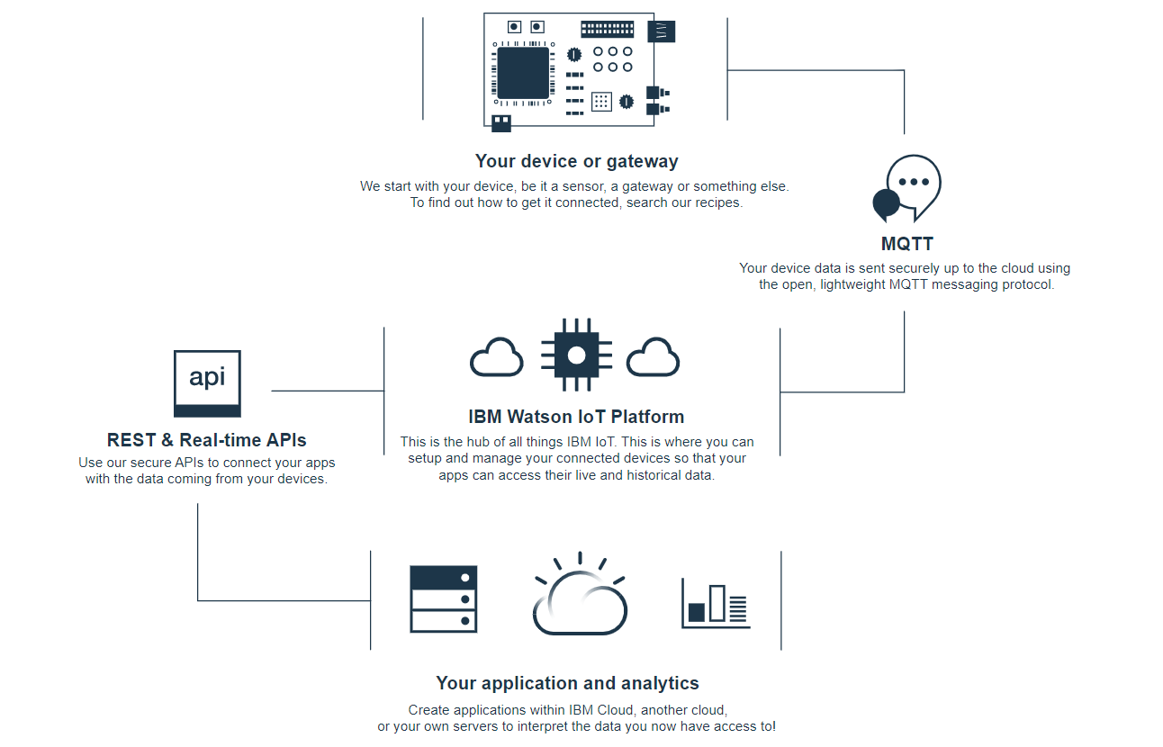
Roadmap

Slide 7
Gas Leakage Monitoring System
ESP32 Microcontroller
Unit
(processing & alert unit)
Weather detection unit (DHT sensor or Weather api.)
MQ6 Gas leakage sensor (using particle per matter ratings)
Use a GPS Location detector to alert the fire station unit in case of a catastrophy (E.g.) An explosion

Slide 8
System Operating Principle
Input: Weather parameters (Test if device is operating in harsh conditions)
Condition: If the temp range (-20⁰C – 70⁰C)
Input: Read from the MQ6 gas sensor
Processing:
Creating alert zones based on the particle per matter value read by the MQ6
Warning Zones:
Send data to the IBM Watson IoT Platform for real-time analysis
Informational alert (LED Green)
Critical alert (LED Blue)
Catastrophic warning (LED Red & Blinking)
Future: Collect data over a period of time and use model to predict usage (residential units)
Future: Collect data of alert warnings and use catastrophic or near explosion warnings to alert Energy Regulation Companies to audit the manufacturing companies producing the gas.

Slide 9
Resources
IBM Watson IoT Platform
ESP32 Microcontroller
Weather Api or DHT sensor (remote rural applications)
GPS coordinate system
Gas leakage sensors & calibrators
IBM Cloud Dashboard (Nodejs)

